Slide 1

Data handling and decision making in wine data

Slide 2

~ OUTLINE ~
Analytical objectives
Assumptions
Data Analysis Process
Data Sanity Checks
Descriptive Analysis and Findings
Predictive Analysis and Findings
Cluster-based Analysis and Findings
Result
Conclusion

Slide 3
Introduction
To begin with, a relation between different variables and the pricing strategy of the Burgundy Sip company is meant to be defined and established.
Moreover, many factor is required to be taken into an account for determining the most suitable pricing strategy.
Indeed, some factors associated with the wines such as rating and indubitably have a positive impact on their popularity and as a result on their demand on market.
Through analyzing the proved data set exploiting r language features, the analytical team shall retrieve and achieve the desired results in regard to the pricing strategy.
In addition, visualization functions shall be use for displaying the relationship between various variable. The relationship should be established for determining the objectives of the whole projects.
Relations amongst the variables assist the data analytics team to devise the most suitable pricing strategy.
Drawing a conclusion in regard to each wine brand and its foreseeable price is the main objective of the process.

Slide 4
Data Understanding
Item 1. Analytical Objectives
Item 2. Assumptions
Item 3. Data Analysis Process

Slide 5
Analytical Objectives
1. Retrieving data regarding the wines which has made the most sales globally.
2. Which wine age is more popular with users based on rating.
3. Which harvest region produces the better wine and consequently higher price.
4. Brand names of each wine and their impact on wine price.
Goals
Increase specific products
Increase customer satisfaction
Focus on specific region
Improve sales strategy

Slide 6
Assumptions
1. Lower ACD leads to a better wine and therefore higher price and popularity.
2. Name of the wine irrespective of its quality is an important factor (more famous higher the price)
3. Wines that are more aged up are costlier compared to ones that are harvested more recently
4. Lowers rsg often means higher price
5. Number of testers and alcohol level does not have a significant effect on pricing
6. BD does not have a noticeable effect on pricing

Slide 7
Data Analysis Process
Data Understanding
Define the Objectives
Data Cleaning
Data Modeling/Exploratory Analysis
visualization
Validation
.Primary information gathering
.Data discovery & characteristics
.Setting the goals
.Evaluate the analytical Process
.Determine data processing objectives
.Categorizing data based on defined factors
.Treat Duplicates
.Treat Outliers
.Treat Missing Values
.Rendering the merged and final data
.Determine important variables
.Explore relationship between variables
.Providing a summary of the data structure
.Descriptive statistics
.Predictive analysis
.Build Model
.Graphs
.Determine best method to demonstrate insights based on analysis
.Communication results
.Provide recommendation
.Evaluate results
.Review process
.Identify Future steps:
(draw a conclusion)

Slide 8
Data Cleaning
Step 0. Variable Analysis
Step 1. Treat Duplicates
Step 2. Treat Outliers
Step 3. Treat Missing Values
Notes:
From here, I will present how we did the Data cleaning to the BurgundySip dataset.

Slide 9
Step 0. Variable Analysis
Step 0-1. Recognize the missing values as NA.
There are 3 types of missing values.
Step 0-2. Transform some Character variables into Numeric.
Unexpectedly RSG, AL and DN are recognized as character because of including blank spaces.
Step 0-3. Transform some variables into Factor.
Because YR, REG and TP are useful as factor.
BurgundySip <- read.csv("BurgundySip.csv", na.strings = c("", "NA", "N.V."));
BurgundySip$RSG <- as.numeric(gsub(" ", "", BurgundySip$RSG));
BurgundySip$REG <- as.factor(BurgundySip$REG);
Notes:
Firstly, we analyzed Variable for this dataset. There are 3 types of missing values.They are blank data, data marked NA, and data marked “N.V.”. “N.V.” means “Non Vintage”, which can be made from grapes that were harvested in different years. By using “na.strings” argument, we substitute within the body of the file, that is, matching strings that should be replaced with NA.
Next, we transform some Character variables into Numeric. Unexpectedly RSG, AL and DN variables are recognized as character in this data set because of including blank spaces. So we transformed those variables into Numeric.
Then, we transform some Character variables into factor as well. In this case, we made YR, REG and TP variables factorized.

Slide 10
Step 0. Variable Analysis
Step 0-4. Check the structure of BurgundySip dataset
str(BurgundySip);
'data.frame': 7500 obs. of 14 variables:
$ SN : chr "W4339-20718" "W9737-31436" "W8398-63402" "W4418-44312" ...
$ NAME: chr "A Coroa" "Aalto" "Aalto" "Aalto" ...
$ WINE: chr "200 Cestos Godello" "Blanco de Parcela" "PS (Pagos Seleccionados) Ribera del Duero" ...
$ YR : Ord.factor w/ 112 levels "1910"<"1911"<..: 111 110 102 106 107 108 109 110 103 107 ...
$ REG : Factor w/ 76 levels "Abona","Alella",..: 73 58 58 58 58 58 58 58 58 58 ...
$ TP : Factor w/ 21 levels "Albarino","Cabernet Sauvignon",..: NA 21 12 12 12 12 12 12 12 12 ...
$ RT : num 4.06 4.21 4.31 4.43 4.32 4.37 4.34 4.32 4.09 4.31 ...
$ NUMR: int 33 80 2207 2858 4411 3383 3239 1108 2844 1884 ...
$ PR : num 23.7 41.9 64 172.5 78.7 ...
$ BD : int NA NA 5 5 5 5 5 5 NA 5 ...
$ ACD : int NA NA 3 3 3 3 3 3 NA 3 ...
$ RSG : num 9.99 8.94 8.22 7 NA ...
$ AL : num 11.1 11.6 11.9 11.4 NA ...
$ DN : num 0.996 0.996 0.995 0.996 NA ...
Notes:
The structure of the BurgundySip dataset is as follows.
We checked the class of each variables.
The data set contains 7500 objectives and 14 variables.

Slide 11
Step 0. Variable Analysis
Step 0-5. Check the summary of BurgundySip dataset
summary(BurgundySip);
REG TP RT NUMR PR BD
Rioja :2433 Rioja Red :2354 Min. :3.920 Min. : 25.0 Min. : 4.99 Min. :2.000
Ribera del Duero:1409 Ribera Del Duero Red:1406 1st Qu. :4.020 1st Qu. : 389.0 1st Qu. : 18.90 1st Qu. :4.000
Priorato : 677 Red : 848 Median :4.100 Median : 404.0 Median : 28.53 Median :4.000
Toro : 297 Priorat Red : 666 Mean :4.154 Mean : 451.1 Mean : 58.21 Mean :4.158
Vino de Espana : 261 Tempranillo : 291 3rd Qu. :4.270 3rd Qu. : 415.0 3rd Qu. : 51.35 3rd Qu.:5.000
(Other) :2380 (Other) :1354 Max. :4.990 Max. :32624.0 Max. :3119.08 Max. :5.000
NA's :43 NA's : 581 NA's :9 NA's :58 NA's :1169
Notes:
The summary of BurgundySip dataset is as follows.This slide shows the summary of some variables and We can figure out the characteristics of each VARIABLE.

Slide 12
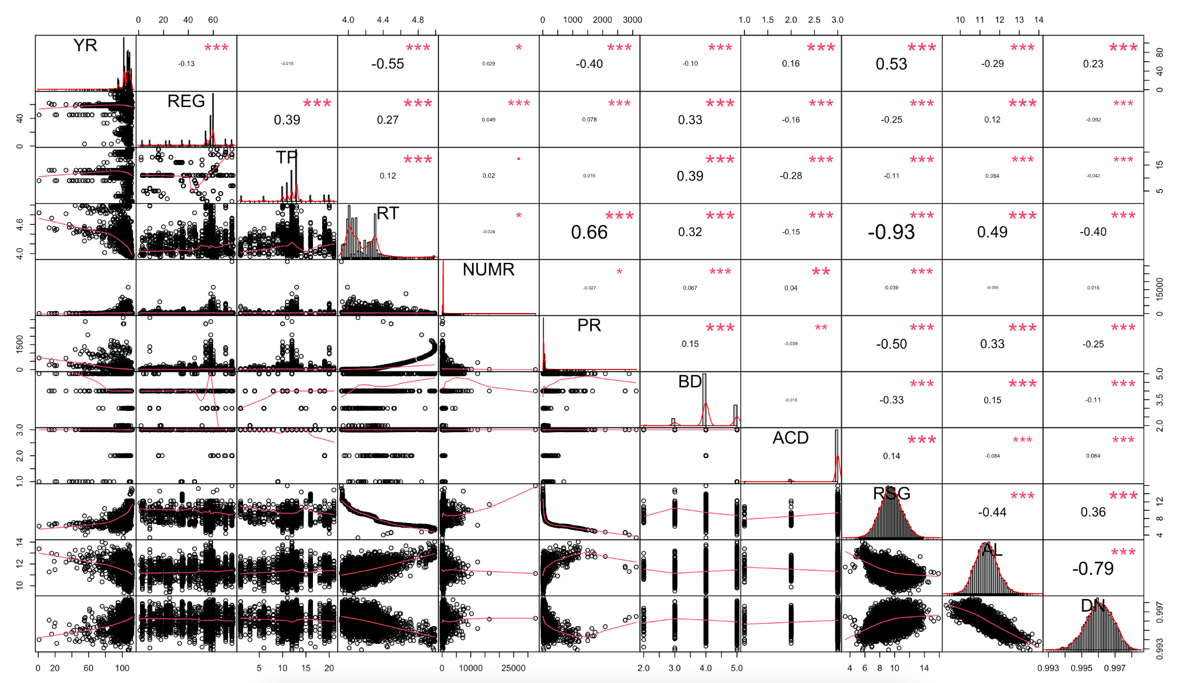
Step 0. Variable Analysis
Step 0-6. Check the correlations of all numeric variables in BurgundySip dataset
chart.Correlation(sapply(BurgundySip[, -c(1, 2, 3)], as.numeric));
Notes:
This slide shows the correlations of all numeric variables in BurgundySip dataset. It allows us to visualize which variables are strongly correlated with each other quickly.

Slide 13
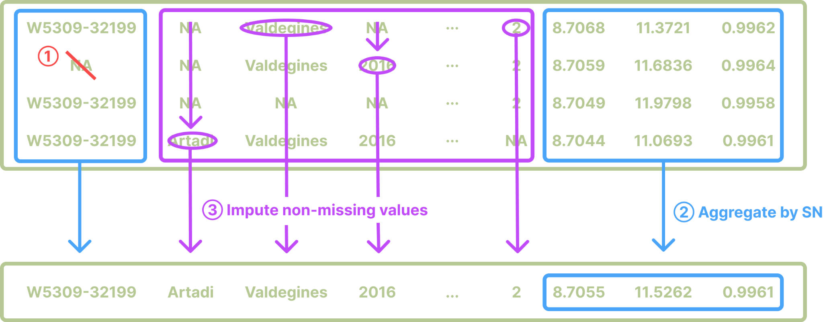
Step 1. Treat Duplicates
Strategy
Notes:
From Here, I gonna present how we treated the duplicates objectives in this data set.
In this case, we did three methods of processing.

Slide 14
Step 1. Treat Duplicates
Step 1. Handle missing values of SN
SN is unique for each wines. And every observations which have same SN are duplicated with other variables excepting for RSG, AL and DN.
We remove the duplicated observations by SN. And fortunately there are only two SNs are missing.
sum(is.na(BurgundySip$SN));
BurgundySip$SN[c(727, 730, 733)] <- BurgundySip$SN[c(726)];
BurgundySip$SN[2072:2115] <- BurgundySip$SN[c(2071)];
sum(is.na(BurgundySip$SN));
[1] 47
[1] 0
Notes:
SN variable is unique for each wines. And every observations which have same SN are duplicated with other variables except for RSG, AL and DN. As shown in the code below, we interpolated to the SN missing .Fortunately there are only two SNs are missing.

Slide 15
Step 1. Treat Duplicates
Step 2. Aggregate RSG, AL and DN by SN
These 3 variables are slightly different by each duplicated observations. We can select every aggregate methods such as max(), min(), mean() and median().
We use the average for aggregating the records.
RemovingDuplicated <- aggregate(cbind(RSG, AL, DN) ~ SN,
data = BurgundySip,
FUN = mean);
RemovingDuplicated;
SN RSG AL DN
1 W1001-62187 9.676400 11.69670 0.9956000
2 W1003-83159 9.385200 11.32470 0.9954000
3 W1007-31751 10.637900 11.48690 0.9954000
4 W1008-45913 11.854237 11.02800 0.9963800
Notes:
RSG, AL and DN variables are slightly different by each duplicated observations. We can select every aggregate methods such as max(), min(), mean() and median(). We used the average for aggregating the records in this case.

Slide 16
Step 1. Treat Duplicates
Step 3. Impute other variables with non-missing values
We want to merge other variables (excepting for SN, RSG, AL and DN) into the aggregated table. But by entering values appropriately, missing values can be efficiently removed.
We return the first non-NA value of the NAME column of Observations with the corresponding SN.
for (rowIndex in 1:nrow(RemovingDuplicated)) {
Duplicated_SN <- subset(BurgundySip,
SN == RemovingDuplicated[rowIndex, "SN"]);
RemovingDuplicated$NAME[rowIndex] <-
Duplicated_SN[!is.na(Duplicated_SN$NAME), "NAME"][1];
RemovingDuplicated$WINE[rowIndex] <-
Duplicated_SN[!is.na(Duplicated_SN$WINE), "WINE"][1];
…
}
Notes:
Last thing is that We want to merge other variables into the aggregated table excepting for SN, RSG, AL and DN.
But by entering values appropriately, missing values can be efficiently removed.
The following code shows that returns the first non-NA value of the NAME column of Observations with the corresponding SN.

Slide 17
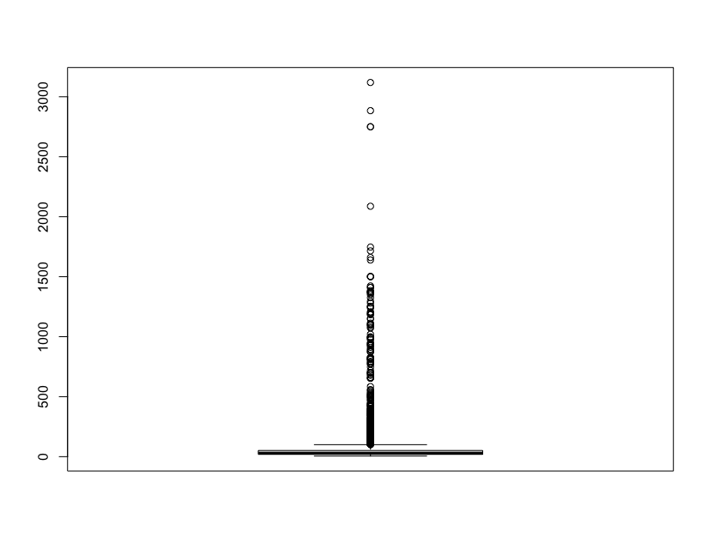
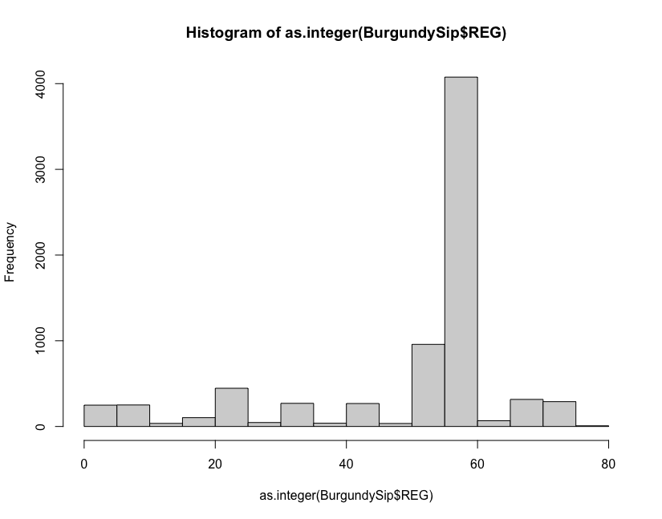
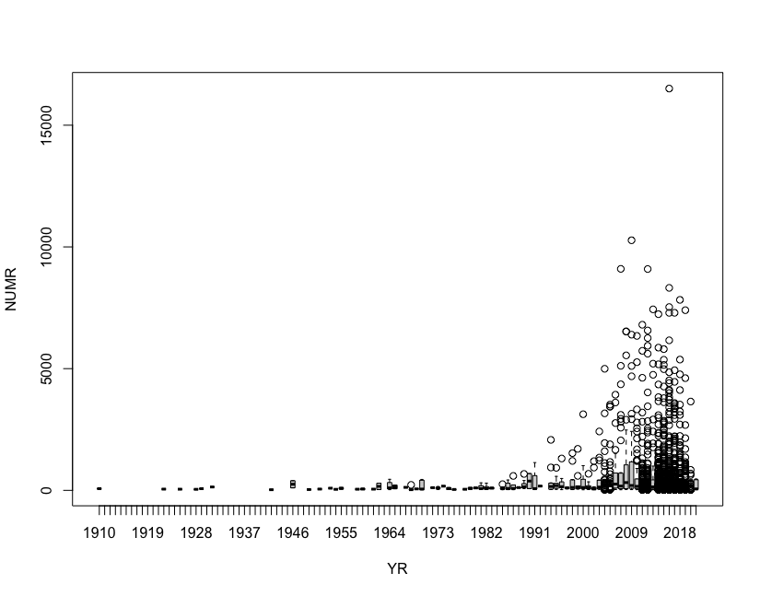
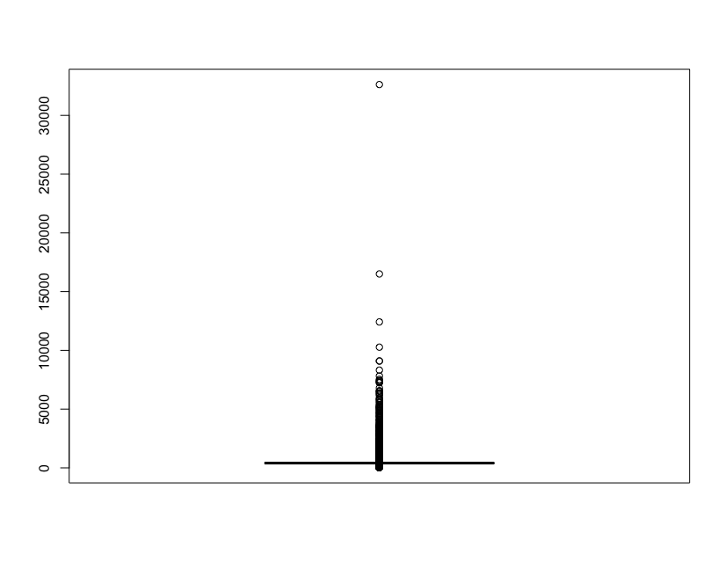
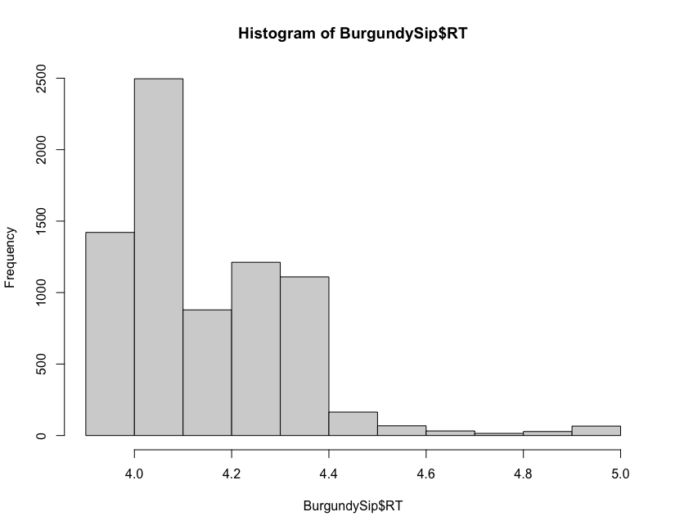
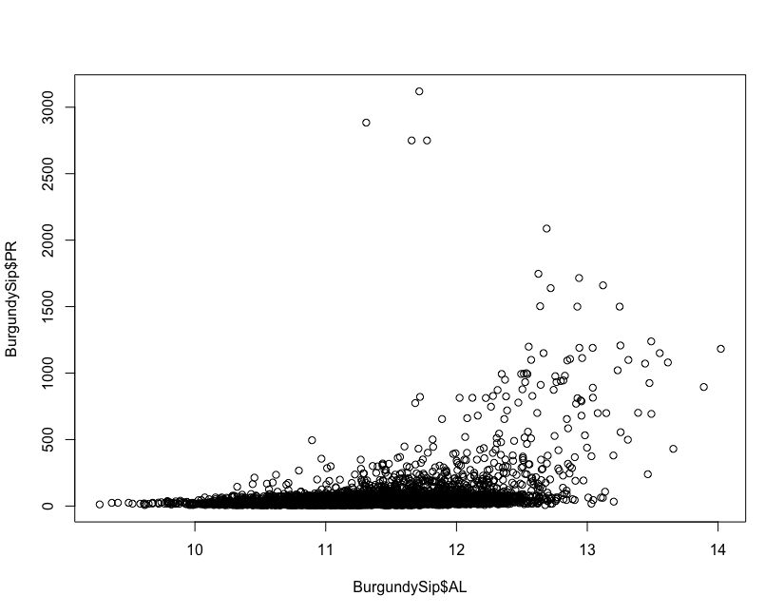
Step 2. Treat Outliers
Global Outliers
Collective Outliers
Contextual Outliers
Notes:
From here, I present how do we treat outliers.
There are three types of Outlier: “Global Outliers”, “Collective Outliers”, and “Contextual Outliers”.
Global Outliers is that if its value is far outside the entirety of the data set in which it is found .
And, If a collection of data points is completely different with respect to the entire data set, it is termed as a collective outlier.
If individual data point is different in a specific context or condition, then it is termed as a contextual outlier.
We visualized each of the variables in this data set as shown in those graphes to confirm the Outliers.

Slide 18
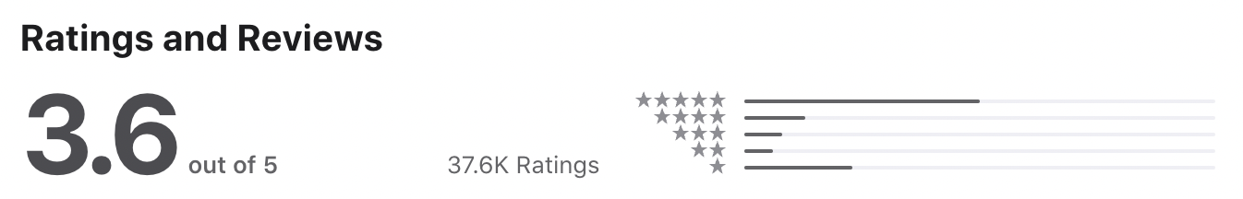
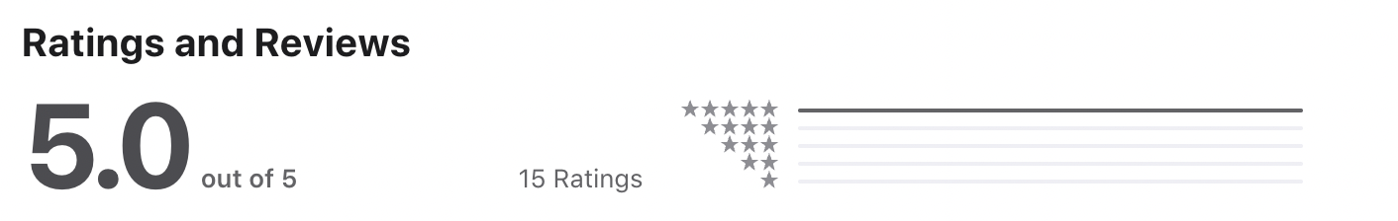
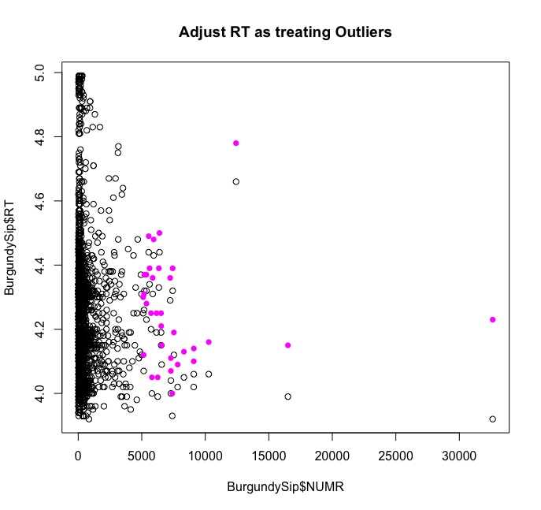
Step 2. Treat Outliers
A large NUMR does not yield a high RT average.
However, Wines with many testers should be weighted RT by NUMR to consider for their popularity compared to Wines with fewer testers.
Step 1. Convert NUMR into Z-score
Step 2. Create a new column RT_WEI with RT weighted
NUMR_Zscores <- (BurgundySip$NUMR - mean(BurgundySip$NUMR)) /
sd(BurgundySip$NUMR);
RT
Fixed a large NUMR
BurgundySip$RT_WEI <- BurgundySip$RT + NUMR_Zscores / 100;
BurgundySip$RT_WEI <- ifelse(BurgundySip$RT_WEI > 5.0, 5.0,
round(BurgundySip$RT_WEI, 2));
NUMR
Notes:
Then, We realized large NUMR does not yield a high RT average.
Taking the upper left chart as an example, the top product is popular and was rated by as many as 38,000 people, and resulting in 3.6 points. On the other hand, the bottom product is not so popular and was rated by only 15 people, resulting in 5.0 points.
This is because, in general, popular products are rated by many people. It can be inferred that a non popular product is less likely to be rated by the antis, although it is likely to be rated by a large number of antis accordingly.
To solve this inequality, we created a new RT variable.
As the code below shows, we converted the NUMR into a Z-score and coded it so that as the Z-score increases, the evaluation points are added.
As a result, as the pink plot in the lower left figure shows, the RT of larger NUMR increased.

Slide 19
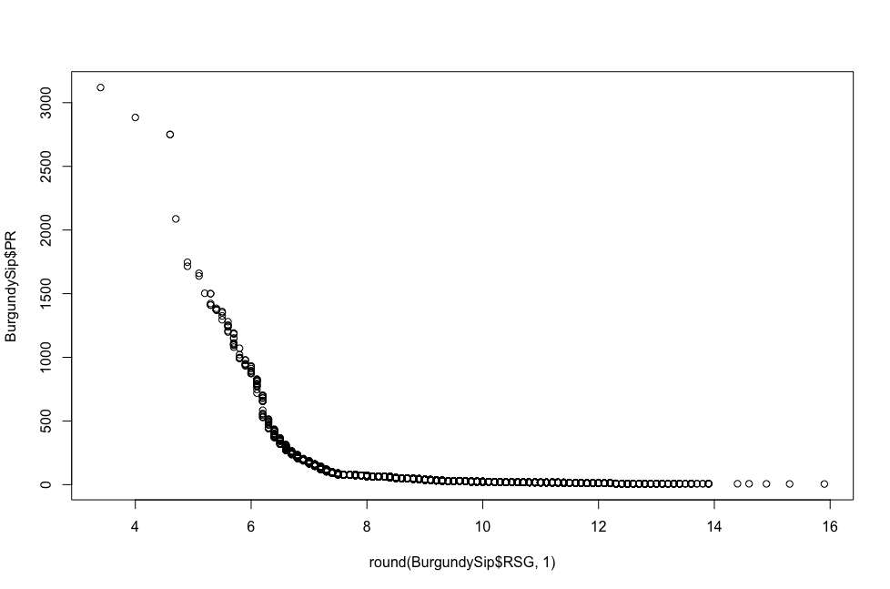
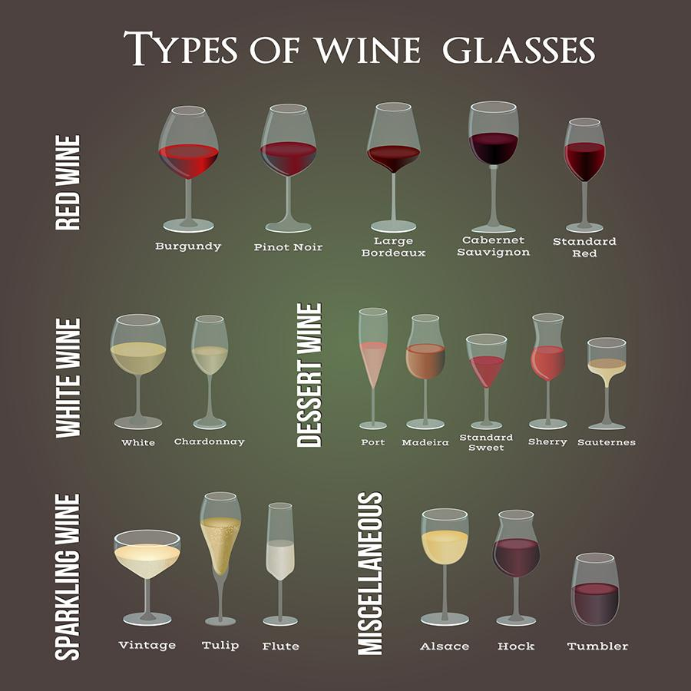
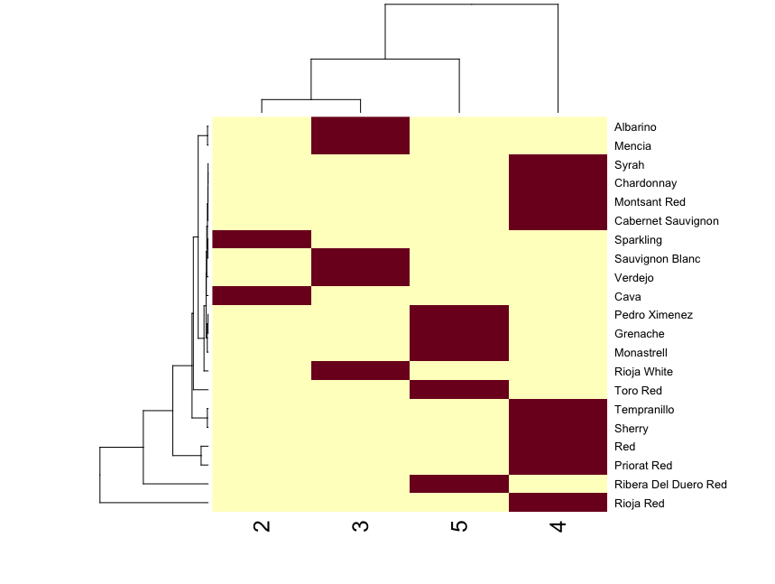
Step 3. Treat Missing Values
5 variables are still missing. We challenge these tasks by mainly 3 approaches.
colSums(apply(BurgundySip, 2, FUN = is.na));
Domain knowledge based
SN RSG AL DN NAME WINE YR REG TP RT NUMR PR BD ACD
0 0 0 0 0 0 144 0 151 0 0 56 433 433
Regression Model Based
Domain Knowledge Based
1 : M Relation Mapping
Notes:
Finally, I explain how we treated the missing values.
At this point, checking the remaining missing values, 5 variables are still missing as upper output shows.
We challenge these tasks by mainly 3 approaches as below, “regression model based”, “Domain knowledge based”, “1:M relation mapping”.

Slide 20
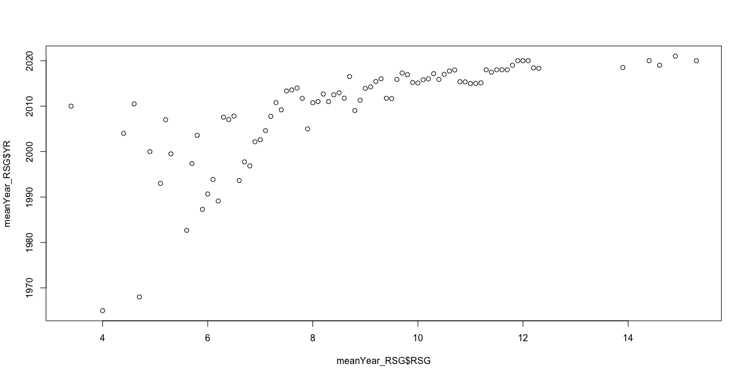
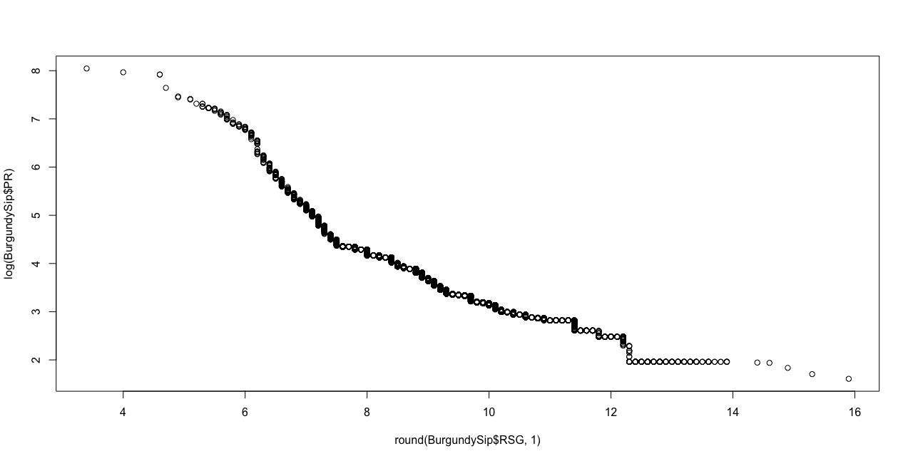
Step 3. Treat Missing Values
Regression Model Based
Both YR and PR have missing values and have a moderate positive correlation with RSG.
Mean YR
Nonlinear Regression suite with this task.
meanYear_RSG <- aggregate(as.integer(as.character(YR)) ~ round(RSG, 1), BurgundySip, FUN = mean);
yearPredictModel <- loess(YR ~ RSG, data = meanYear_RSG);
predictYR <- predict(yearPredictModel, missingYR_RSG);
RSG
Linear Regression suite with this task.
Logarithm of PR
pricePredictModel <- lm(log(train_PR) ~ train_RSG);
coefficients(pricePredictModel);
predictPR <- exp(1)^(-0.7572643 * test_RSG + 10.4689374);
(Intercept) train_RSG
10.4689374 -0.7572643
RSG
Notes:
Firstly, i explain about the method based on regression models.
We checked the correlation of with other variables, then we found that both YR and PR have a moderate positive correlation with RSG.
The upper figure shows a graph plotting the average RSG for each year. It displays the beautiful quadratic curve.
Therefore, as the upper code indicates, we created a Nonlinear Regression model with YR as the dependent variable and the average RSG for each year as the independent variable to predict and impute the missing values of YR.
On the other hand, the lower figure shows the logarithm of PR for each RSG.It displays the beautiful straight line.
Therefore, as the lower code indicates, we created a linear Regression model with the logarithm of PR as the dependent variable and RSG as the independent variable to predict and impute the missing values of PR.

Slide 21
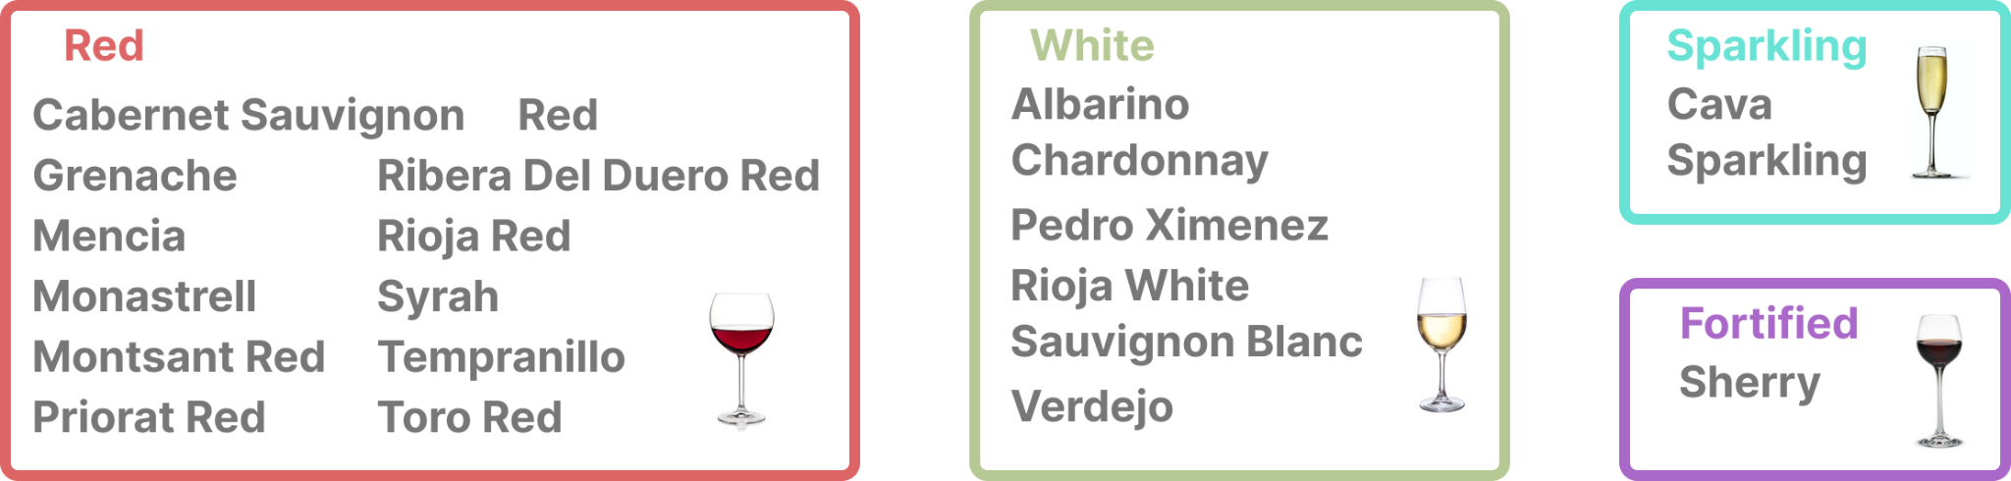
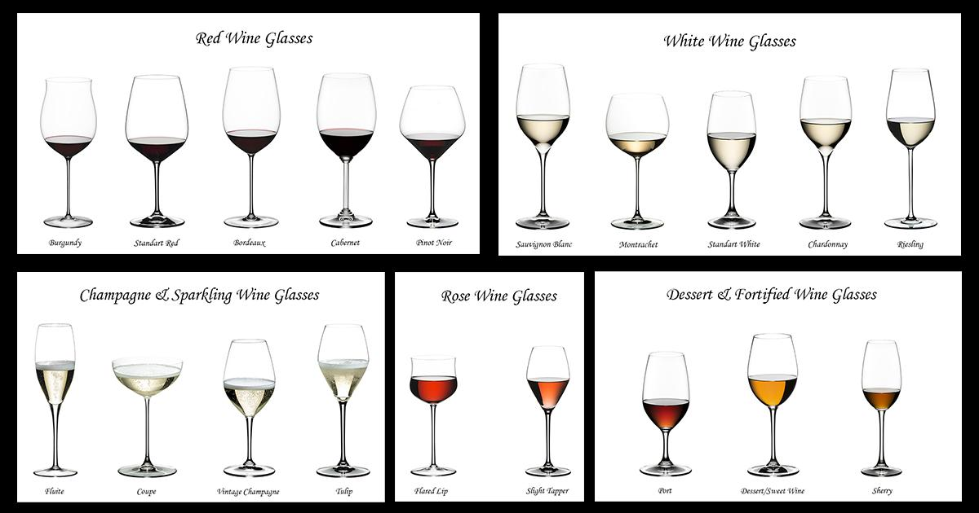
Step 3. Treat Missing Values
Domain Knowledge Based
We found that TP of the dataset don’t cover all types of wines. The top left image shows the distribution of TP. Most of them are Red wine.
On the other hand, the wines which has missing TP are White, Sparkling, Rose and Dessert. We decide to keep these wines and research which type of wine.
We assume Major category of wine ("Red", "White", "Rose", "Sparkling" and so on) behave similar features with original TP.
# There are 68 wines which has missing TP.
length(naTP_BurgundySip[!duplicated(naTP_BurgundySip$WINE),]$WINE);
levels(BurgundySip$TP) <- c(levels(BurgundySip$TP), "White", "Rose", "Dessert", "Fortified");
BurgundySip$TP[BurgundySip$WINE == "Treixadura"] <- "White";
BurgundySip$TP[BurgundySip$WINE == "Tintilla de Rota"] <- "Red";
BurgundySip$TP[BurgundySip$WINE == "Pla dels Angels Rosado"] <- "Rose";
Notes:
Next, i explain about the method based on domain knowledge.We found that TP variable don’t cover all types of wines. The top left image shows the distribution of TP. Most of them are Red wine. On the other hand, the wines which has missing TP are White, Sparkling, Rose and Dessert. We decide to keep these wines and research which type of wine. We assume Major category of wine ("Red", "White", "Rose", "Sparkling" and so on) behave similar features with original TP.

Slide 22

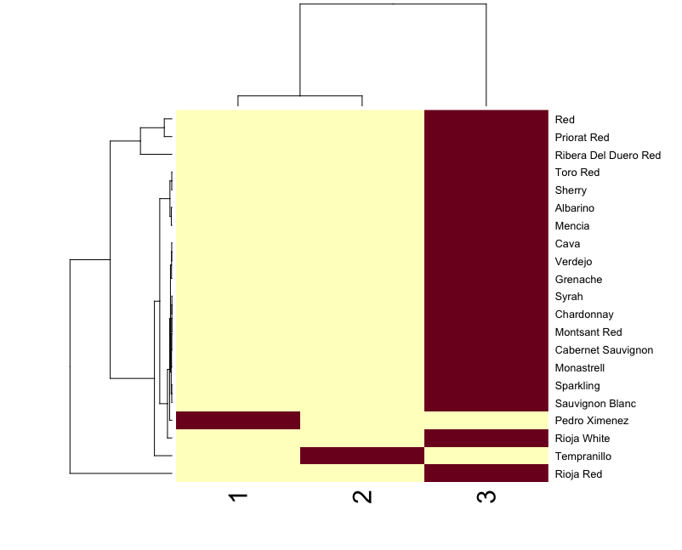
Step 3. Treat Missing Values
1 : M Relationship Mapping
Both BD and ACD have missing values and have a 1 : Many relationship with TP.
YES
NO
LeftJoin with 1:M mapping table
TP
bdTPTable <- aggregate(BD ~ TP, BurgundySip, FUN = mean);
missingBD_BurgundySip <- BurgundySip[is.na(BurgundySip$BD),];
existingBD_BurgundySip <- BurgundySip[!is.na(BurgundySip$BD),];
removeBDIndexes <- !(names(BurgundySip) == "BD");
missingBD_BurgundySip <-
merge(missingBD_BurgundySip[removeBDIndexes],
bdTPTable,
by = "TP",
all.x = T);
BurgundySip <- rbind(existingBD_BurgundySip, missingBD_BurgundySip);
BD levels
TP
ACD levels
Notes:
And finally, i explain about the method based on 1:M relationship mapping.
Both BD and ACD have missing values and have a 1 : Many relationship with TP.
The upper heatmap shows the BD level for each TP, and the lower one shows the ACD level for each TP. This chart shows that BD and ACD have a 1:M relationship with TP. Therefore, the missing values of BD and ACD can be impute from the TP of their objective, respectively.

Slide 23
Modeling
Item 1. Descriptive Questions
Item 2. Predictive Analytics (Regression)
Item 3. Predictive Analytics (Cluster)

Slide 24
Item 1. Descriptive Analysis & Questions
During the exploratory analysis :
1. Which particular range of age (YR) in regard to wines had the highest price?
2. Determine the rating range pertaining to the wines which had the highest price.
3. What is the average price of wines based on the region which the grapes are originated from ?
4. Calculate the average price of wines based on the name of the aforementioned beverages
5. The average price of the wines based on the ratings pertinent to each brand.

Slide 25
Item 1. Descriptive Analysis & Questions
Conclusion / Answers Part.1
As a matter of fact, there was no perfect correlation between the price and the year which the grapes were reaped. Contriving a pricing plan based on the YR seems rather inane. There are better options to base pricing strategy on.
Moreover, as the regression models indicate, the attributed rating above 4.5 to the beverages lead to higher prices. PLUS, the rating which falls below the 4.5 decrease the price, as a result, it can be concluded that the rating has a strong positive impact on the pricing strategy.
A relation can be found between region and the pricing. indeed, Conca de Barbera, Aragon, Jerez Palo Cortad, Montilla-Moriles, Mentrida as different regions recorded a higher prices compared to other regions. Though most of the wines based on region falls in the average price category, there are slight and noticeable differences between the wines.
Price of the wines vary significantly based on the names of the wineries. Understandably, a few names such as Clos Erasmus, Emilio Hidalgo, Espectacle del Montsant and etc. have a weighty higher price compared to others.

Slide 26
Item 1. Descriptive Analysis & Questions
Conclusion / Answers Part.2
As mentioned earlier, there is a strong relation between rating and price. As the rating goes higher the prices moves in the same direction (positive covariance).
> BurgundySip <- read_csv("F:/FP/BurgundySip.csv")
> View(BurgundySip)
> aggregate(BurgundySip$PR ~ BurgundySip$REG, FUN = mean)
> aggregate(BurgundySip$PR ~ BurgundySip$NAME, FUN = mean)
> aggregate(BurgundySip$PR ~ BurgundySip$RT, FUN = mean)

Slide 27


Item 2. Predictive Analytics (Regression)
Business strategy
<Predictive Objective 1>
Predict prices based on wine characteristics.
<Predictive Objective 2>
Suggest to customers highly rated wines based on predictable wine prices and wine characteristics.

Slide 28
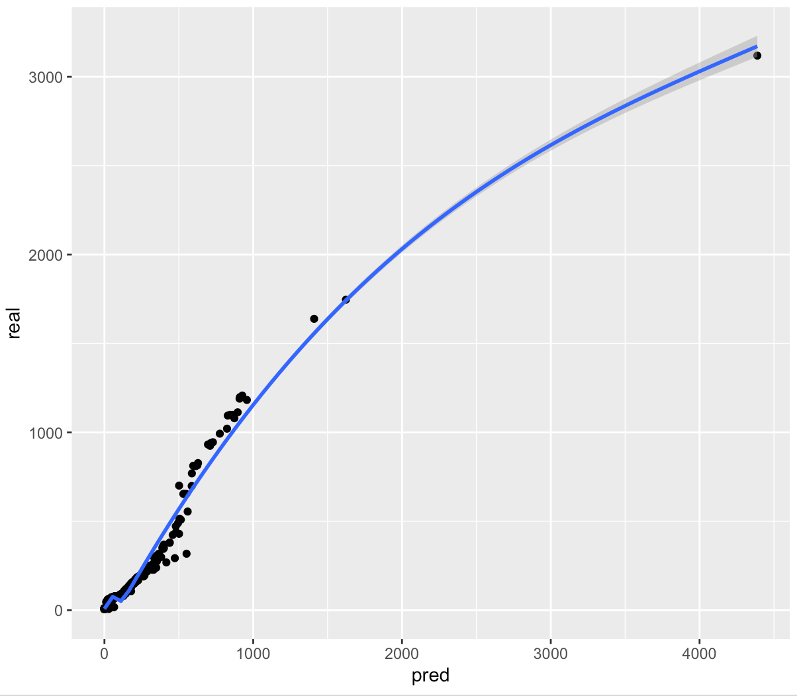
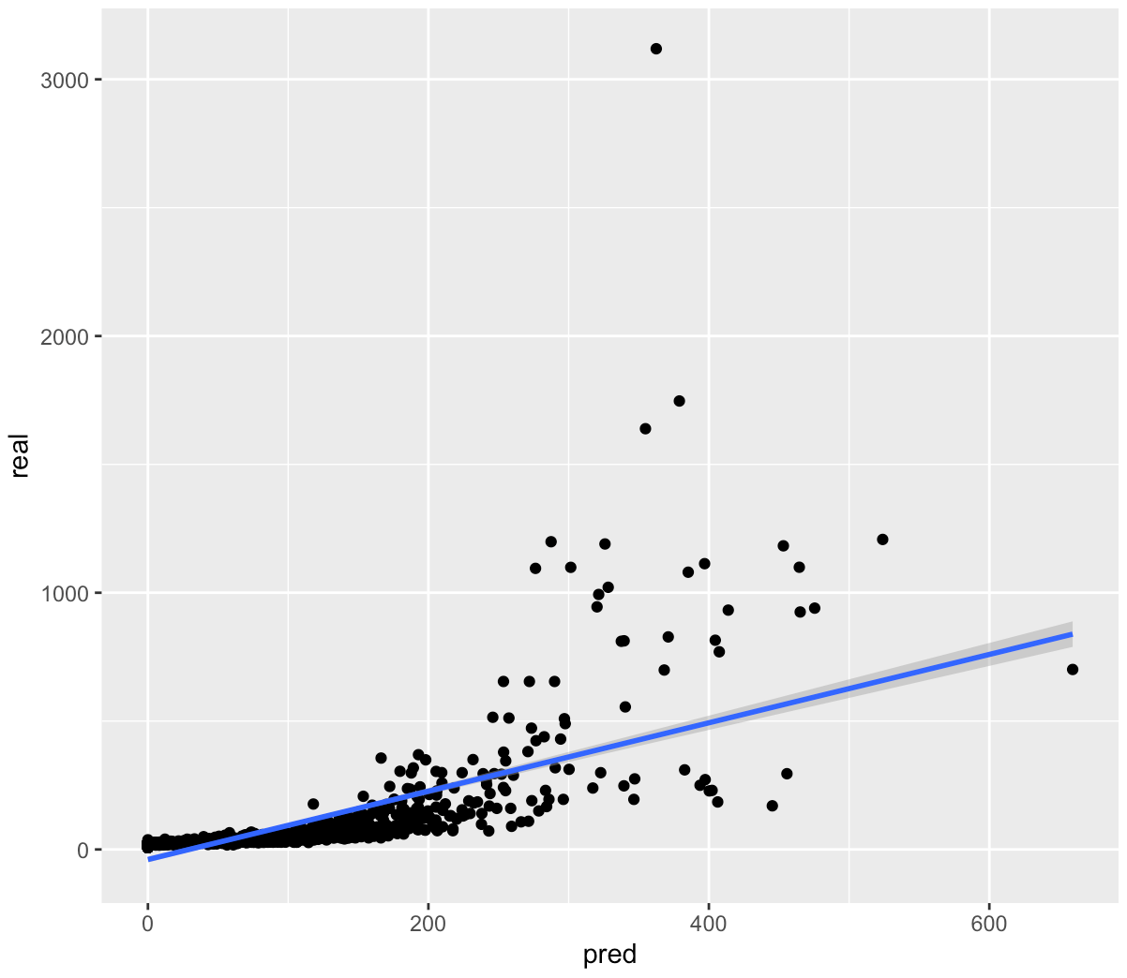
Item 2. Predictive Analytics (Regression)
Predictive Objective 1: Predict prices based on wine characteristics.
Non Linear regression
Linear regression
Real Value(€)
Real Value(€)
Prediction Value(€)
Prediction Value(€)

Slide 29
Item 2. Predictive Analytics (Regression)
Predictive Objective 1: Predict prices based on wine characteristics.
High Accuracy
Real Value(€)
Real Value(€)
Prediction Value(€)
Prediction Value(€)

Slide 30
Item 2. Predictive Analytics (Regression)
Predictive Objective 1: Predict prices based on wine characteristics.
<Polynomial Linear Regression>
Dependent variable: PR
Independent variables: RSG, YR, AL, DN
<Train the polynomial Linear Regression Model>
set.seed(101);
sample <- sample.split(BurgundySip, SplitRatio = 0.70);
train = subset(BurgundySip, sample == TRUE);
test = subset(BurgundySip, sample == FALSE);
model <- lm(PR ~ poly(RSG, degree = 4, raw =
TRUE)+poly(YR, degree = 3, raw = TRUE) +
poly(AL, degree = 2, raw = TRUE) +
DN,
train,control=loess.control(surface="direct"));
PR.predictions <- predict(model,test);
Real Value(€)
Prediction Value(€)

Slide 31
Item 2. Predictive Analytics (Regression)
Predictive Objective 1: Predict prices based on wine characteristics.
<Polynomial Linear Regression>
R-squared: 0.9101898
<Calculating R-squared>
mse <- mean((results$real-results$pred)^2);
mse^0.5;
SSE = sum((results$pred - results$real)^2);
SST = sum((mean(BurgundySip$PR) - results$real)^2);
R2 = 1 - SSE/SST;
Real Value(€)
Prediction Value(€)

Slide 32

Item 2. Predictive Analytics (Regression)
Predictive Objective 2: Predict highly rated wines based on prices & characteristics
We want to propose good wines to our customers!
In this case, we used a logistic regression model to predict RT greater than 4.5 (good wine) and RT less than 4.5 (bad wine).
😁
😟
RT > 4.5
RT <= 4.5

Slide 33
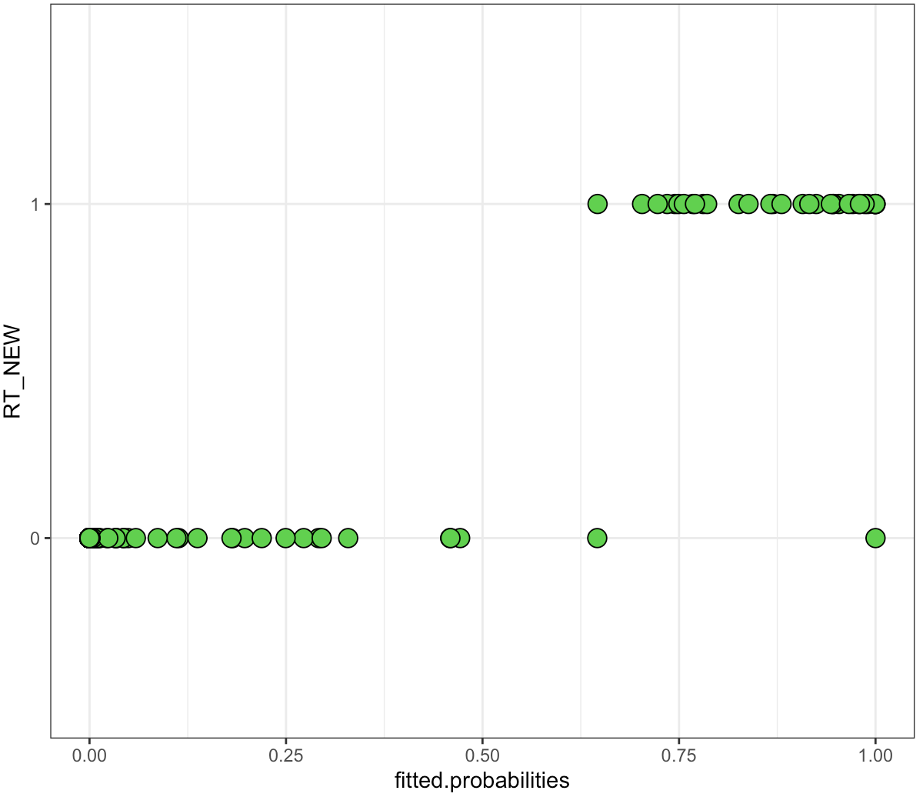
Item 2. Predictive Analytics (Regression)
Predictive Objective 2: Predict highly rated wines based on prices & characteristics
<Logistic Regression>
Dependent variable: RT_NEW(1: RT > 4.5, 0 : RT<= 4.5)
Independent variables: RSG, YR, AL, DN, PR
<Train the Logistic Regression Model>
BurgundySip$RT_NEW <-ifelse(BurgundySip$RT>4.5 , 1, 0);
set.seed(101);
sample <- sample.split(BurgundySip, SplitRatio = 0.70);
train = subset(BurgundySip, sample == TRUE);
test = subset(BurgundySip, sample == FALSE);
train$RT_NEW <- factor(train$RT_NEW);
train <- select(train, RSG,AL,DN,RT_NEW,PR,YR);
log.model <- glm(RT_NEW ~ . , family
=binomial(link='logit'),data = train);
Real RT(1 or 0)
Probability RT(1 or 0)

Slide 34
Item 2. Predictive Analytics (Regression)
Predictive Objective 2: Predict highly rated wines based on prices & characteristics
<Logistic Regression>
Predicting using Test data…
Accuracy 0.997267759562842
<Predicting by using Test Data>
split = sample.split(train$RT_NEW, SplitRatio = 0.70);
final.train = subset(train, split == TRUE);
final.test = subset(train, split == FALSE);
final.log.model <- glm(formula=RT_NEW ~ . , family =
binomial(link='logit'),data = final.train);
fitted.probabilities <-predict(final.log.model,newdata =
final.test,type='response');
fitted.results <- ifelse(fitted.probabilities > 0.5,1,0);
misClasificError <- mean(fitted.results != final.test$RT_NEW);
print(paste('Accuracy',1-misClasificError));
Real RT(1 or 0)
Probability RT(1 or 0)

Slide 35
Item 2. Predictive Analytics (Regression)
Conclusion
<Predictive Objective 1>
Independent variables: RSG, YR, AL, DN
To predict wine prices by Nonlinear regression model : R-squared values 0.91
<Predictive Objective 2>
Independent variables: PR, RSG, YR, AL, DN
To predict wine ratings by Logistic regression model : Accuracy values 0.99
・Residual sugar level (RSG)
・Year of production (YR)
・Alcohol level (AL)
・Density or gravity of wine (DN)
To make a good wine, these factors must be considered.
Notes:
(Sidra)
We implemented a linear regression model and a nonlinear regression model as models for predicting PR, and compared the validation results with train data and test data .As a result, the Non linear regression model is considered to be the most appropriate model with an R-squared of approximately 0.91.It is quite high accuracy.In this models we use PR(price of the wine) as dependent variable and RSG, YR, AL and DN as the independent variables. We use mean squared error method too and the R-squared value of non-linear model was higher as compare to linear model , and the non-linear regression model provides the most flexible curve fitting functionality which linear model doesn’t provide thats why non-linear model provide better results in our case
We implemented a logistic regression model to determine wines with a rating higher than 4.5 with a rating lower than 4.5 based on RSG, AL, DN & YR which are correlated with RT, we tested this model on both train and test data, and created a model with an accuracy of approximately 0.99~1.
(Koichiro)
We implemented a linear model regression model and a nonlinear regression model as models for predicting PR, and compared the validation results with train data and test data. The non linear regression model is considered to be the most appropriate.As a result, the Non linear regression model is considered to be the most appropriate model with an R-squared of approximately 0.91.It is quite high accuracy.
We also implemented a logistic regression model to determine wines with a rating higher than 4.5 with a rating lower than 4.5. We tested this model on both train and test data, and created a model with an accuracy of approximately 0.99. It is quite high as well.
In addition to the fact that wine price and wine evaluation are correlated with each other, the place of production (RSG), year of production (YR), alcohol level (AL), and concentration (DN) are considered to be the best significant features for the model.
One concern is overfitting. It falls into the trap of overfitting too much to each individual element of the data without capturing the overall trend of the data. It could lead to inaccuracies when different data are fit to the model.If we implement Cross-Validation, which minimizes Overfitting, we can expect to pursue higher quality models.

Slide 36


Item 3. Predictive Analytics (Cluster)
TASTE
BRAND
Analyzing potential groupings based on taste of Wine
Analyzing potential groupings based on brand of Wine
Discover potential high-demand wines
Notes:
What is your idea about these cluster questions!?
Run k-means clustering to detect the top 5 or 10 favourable wine classes (kinds) based on their age/rating.
Plot the 5 or 10 classes(kinds) using a scatter plot and different colour points.
Consumer behaviour (customers interact with which of the wine brands )
Use a scatter plot (a dot plot) to map the relationship between the brand and the age or price of the wine
• Which type of wine is popular with regards to taste.

Slide 37
Item 3. Predictive Analysis (Cluster)
Cluster based on Taste
RSG
residual sugar level
AL
alcohol percentage
DN
density and gravity
ACD
acidity score
BD
body score
Model 1
Model 2
Model 3
…
BurgundySip_TasteNum <- data.frame(sapply(BurgundySip[, !sapply(BurgundySip, is.character)], as.numeric));
fit <- kmeans(BurgundySip_TasteNum[, c("RSG", "AL", "DN", "ACD", "BD")], 5);
BurgundySip_TasteNum$cluster <- as.factor(fit$cluster);

Slide 38
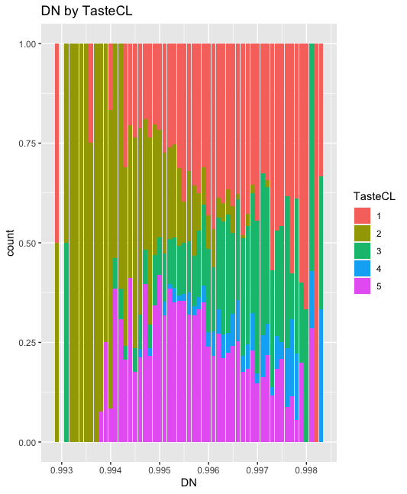
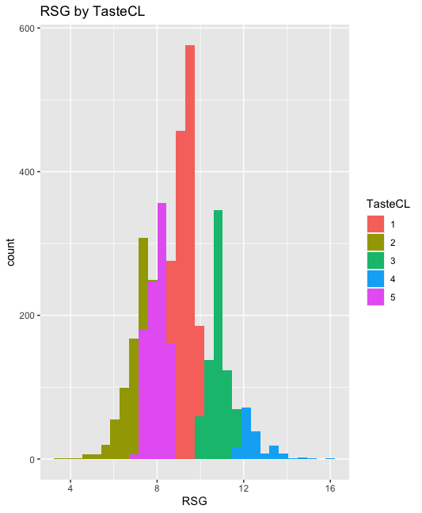
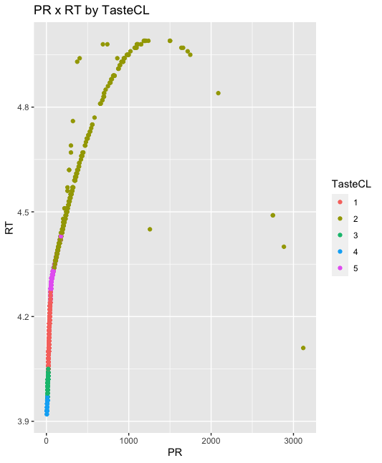
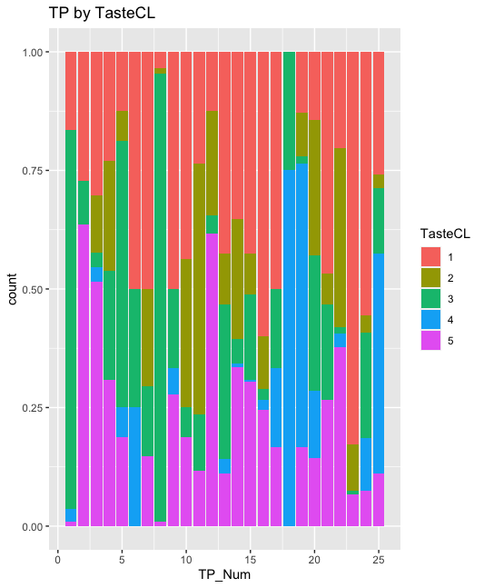
Item 3. Predictive Analysis (Cluster)
Cluster based on Taste
1: Middle
2: Lowest Sugar Level and Density
3: 2nd Highest Sugar Level
4: Highest Sugar Level and Density
5: 2nd Lowest Sugar Level
The cluster is highly dependent on Sugar Level. However, since both PR and RT are dependent on Sugar Level, they could be classified cleanly.
We succeeded in classifying wines by acidity and sweetness information, independent of the type of wine, such as RED, White, Dessert, and so on.
Some regions produce only the sweetest wine, which is a very interesting result.

Slide 39
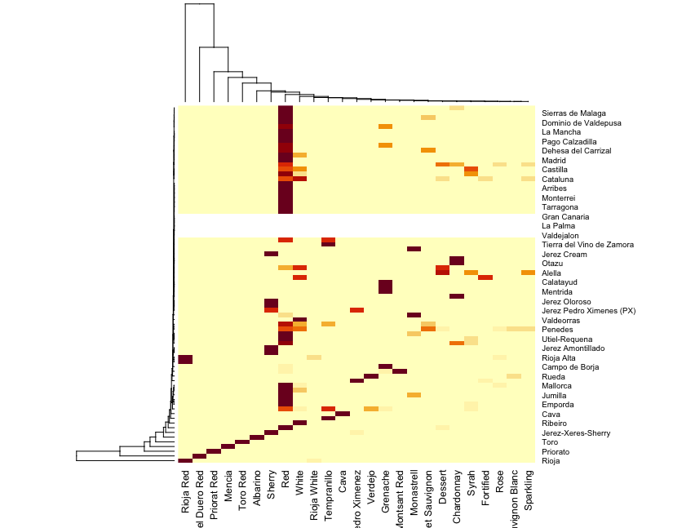
Item 3. Predictive Analysis (Cluster)
Cluster based on Brand
REG distribution vectors by TP
TP_Grenache = [0 0 0 1 0 1 0 0 0 0 0 1 1 1 0 1 0 0 0 0 …]
TP_White = [0 0 1 0 1 0 0 0 1 0 1 0 0 0 1 1 1 0 0 0 …]
TP_Dessert = [0 1 1 0 0 0 0 0 0 0 0 0 0 0 0 1 1 0 0 0 …]
TP_Syrah = [0 1 0 0 0 0 0 0 0 0 1 0 0 0 1 1 0 0 0 0 …]
REG_TP_Matrix <- table(BurgundySip$REG, BurgundySip$TP);
REG_TP_DataFrame <- # convert REG_TP_Matrix into data frame
BurgundySip_Brand <- merge(BurgundySip, REG_TP_DataFrame, by = "REG", all.x = T);
BurgundySip_BrandNum <- data.frame(sapply(BurgundySip_Brand[, !sapply(BurgundySip_Brand, is.character)], as.numeric));
fit <- kmeans(BurgundySip_BrandNum[, columnNams_TP], 10);
BurgundySip_BrandNum$cluster <- as.factor(fit$cluster);

Slide 40
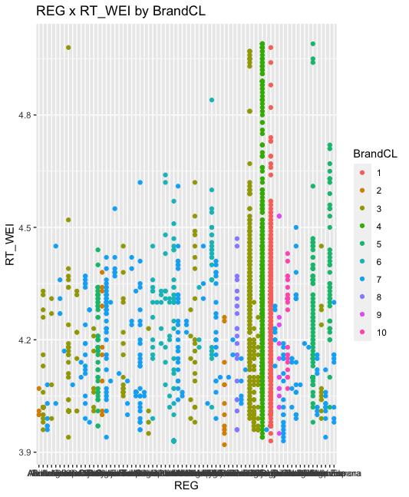
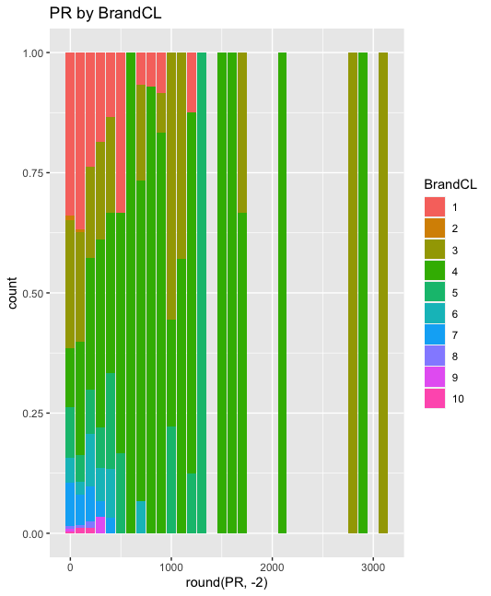
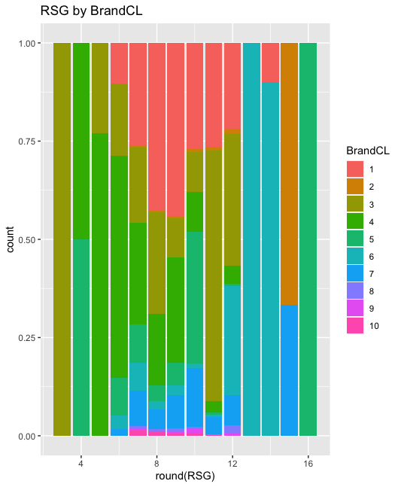
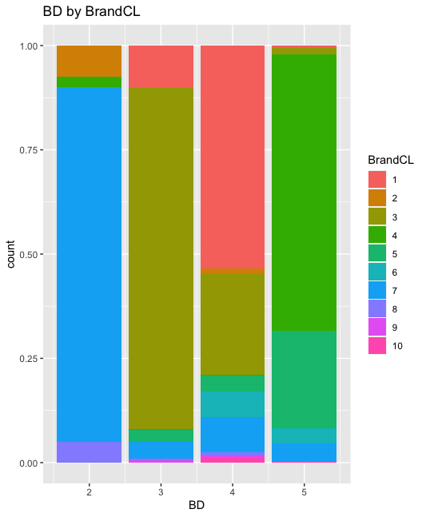
Item 3. Predictive Analysis (Cluster)
Cluster based on Brand
1: BD = 4 & Rioja
6: Higher Sugar
2: 2nd Highest Sugar
7: BD = 2
3: BD = 3 & Lowest Sugar
8: Penedes
4: Lower Sugar & Ribera del
9: Rioja Alta
5: Highest Sugar
10: Sardon de Duero
We succeeded in summarizing the Regions with similarities by using the distribution vector of Regions for each Type.
The outcome revealed significant differences in Sugar Level and Body Score, despite the clustering was conducted without using component data of wine.
It indicates that each brand has a distinctly different taste.

Slide 41
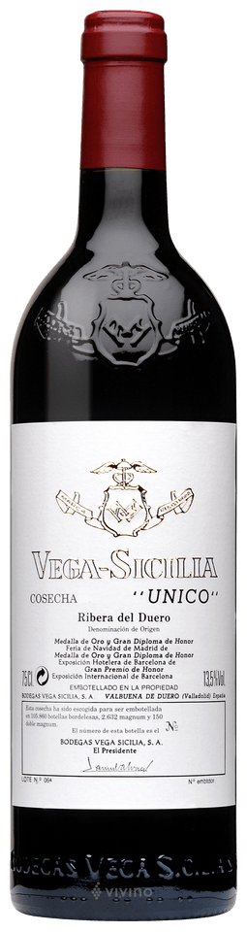
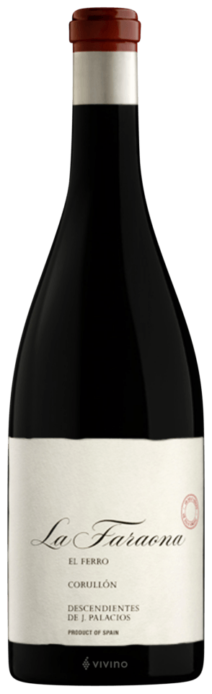
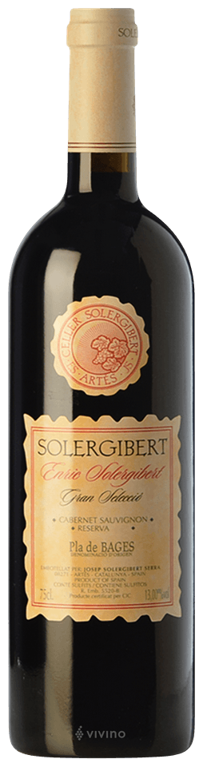
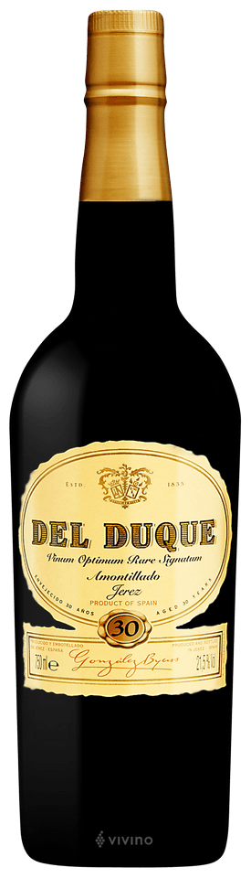
Item 3. Predictive Analysis (Cluster)
Conclusion
Suggestion 1
Suggestion 2
Taste Cluster:
Brand Cluster:
High Quality
High Price
2
Taste Cluster:
Brand Cluster:
High Quality
Low Price
5
3
or
6
or
8
4
High-quality, high-priced wines can generate stable profits.
High-quality, low-priced wines can be loved by many customers who want to enjoy wine at ease.

Slide 42
Conclusion

Slide 43
Conclusion
1. Lower ACD leads to a better wine and therefore higher price and popularity.
It does not have a significant effect(Non linear regression model)
2. Name of the wine irrespective of its quality is an important factor (more famous higher the price)
Yes, but not directly (Name of wine → Sugar Level → Price) (Cluster-based)
3. Wines that are more aged up are costlier compared to ones that are harvested more recently
Yes, an older wines tend to be more expensive.(Non linear regression model)
4. Lowers rsg often means higher price
Yes (Cluster-based)
5. Number of testers do not have a significant effect on pricing
It does not have a significant effect(Non linear regression model)
6. BD does not have a noticeable effect on pricing
It does not have a noticeable effect(Non linear regression model )

Slide 44
E.o.F

